Slide 1
FINAL ASSESSMENT
VAISHNAVI R NATH

Slide 2
Question 1
There are no duplicate values in the data given
Created a two new columns(likes_new,dislikes_new) for replacing the null values to the median of corresponding columns.

Slide 3
Question 2
Difference between the publish and trending date is calculated by normal arithematic function.
The average time gap for a video to trend is 2.221284
From the pie chart it is understood that mostly the date difference is 1 for a video to trend to a maximum of 14 days for 1 video

Slide 4
Question 3
Using vlookup found the category for every categoryid
Sports category have more likes compared to other categories
The count of education channels are more compared to other channels.
unique_category | count | count of likes
News & Politics | 42 | 55829
Comedy | 11 | 13335.5
Sports | 87 | 490167.5
Entertainment | 113 | 246964.5
Film & Animation | 7 | 4802
People & Blogs | 68 | 56427.5
Music | 11 | 9004
Education | 146 | 216952
Science & Technology | 31 | 93773.5
Howto & Style | 75 | 70434.5
Autos & Vehicles | 1 | 1022

Slide 5
Question 4
Filtered the data using only channel name “ABN Telugu”.47 columns out of 48 are news and politics channel
Only 1 from 48 are sports in ABN Telugu

Slide 6
Question 5
Concatenated the tile and channel title using concatenate function

Slide 7
Question 6
Average comment count of each video is plotted
The number of channel where the comments are disable is 592 and not disabled is 15715

Slide 8
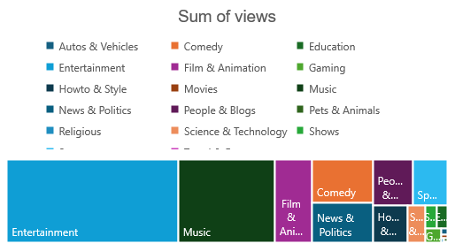
Question 7
Sum of views
11146317224

Slide 9
Question 8
Top five videos of more views
Last five videos of less views
video_id | views
FlsCjmMhFmw | 125432237
6ZfuNTqbHE8 | 89930713
u9Mv98Gr5pY | 53822757
QwievZ1Tx-8 | 45064699
rRr1qiJRsXk | 44171797
video_id | views
wntggWeDxjI | 4024
iW5ZRboFCMU | 4287
18OSLOq-bFA | 4359
p3Wn9FuI2zo | 5098
4fKgKl8W3ws | 5437
video_id | likes
xhCRRthTs7I | 2912710
_JVghQCWnRI | 2606663
hYlYziTc0pA | 1804377
hCH-S62dGuU | 1721384

Slide 10
Question 9
Finding weekdays for each publish and finding whether the views differs.
Most of the videos are published on Fridays which will increase the view counts of videos because of the coming holidays
day | count | sum of view
Sunday | 1721 | 1011825920
Monday | 2246 | 1723553736
Tuesday | 2390 | 1727591808
Wednesday | 2333 | 1879599119
Thursday | 2503 | 1743826396
Friday | 2694 | 1678990966
Saturday | 2420 | 1380929279

Slide 11
Question 10
Sum of comment_count | Sum of likes | Sum of views | in count | IN LIKES | IN VIEWs
6422378 | 59063929 | 2700407997 | 0 | 0 | 0
17741295 | 176409897 | 8445909227 | 176.2418 | 198.6762 | 212.7642
There is a increase in likes views and count in 2018 compared to previous year 2017

Slide 12
Question 13
Using Vlookup we would be able to find the comment count for each category

Slide 13
Question 14
Row Labels | Count of video_id
Autos & Vehicles | 2
Education | 116
Entertainment | 194
Film & Animation | 24
Howto & Style | 13
Music | 4
News & Politics | 108
People & Blogs | 82
Religious | 42
Science & Technology | 4
Sports | 3
Grouping videos by category using pivot table

Slide 14
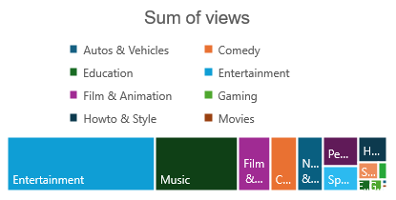
Question 16
Sum of views
11146317224
Count of columns
16308

